Slide 1
PROJECT TITLE : EFarmer
PIP104 University Project-II
Review-1
Batch Number: CSE-G14
Roll Number | Student Name
20201CSE0171 | Daggula Sree Bhargav Reddy
20201CSE0116 | Maligireddy Abhiramreddy
20201CSE0170 | Kodidala Babu
Under the Supervision of,
Dr. Raghavendra. M. Devadas
Professor
School of Computer Science & Engineering
Presidency University

Slide 2
Introduction
E-Farming is clearly a beginning to have a major impact in the agricultural sector.
The way people go about purchasing agricultural products is of great concern.
Most of the time customers have to travel far distances to get agricultural products and getting the right quality is not ensured.
Even after all the hard work and the production done by the farmers, in today’s market the farmers are cheated by the Agents, leading to a great loss.
This project aims to help farmers as well as customers for buying and selling agricultural products directly using a computerized approach.

Slide 3
Literature Review
Sl No | Year | Reference | Relevant
1 | 2015 | E-farmer Management System for Agrarian Service Centre in Sri Lanka (Karunarathna, KNNS Vida agama, DU) | The E-farmer Management System (EFMS) would be built with the use of Web based technology with C# language.
2 | 2017 | E-Farmer Self Service(Tharani K ,Varsini N ,Revathi K ,Sri Karthick M) | The website will guide the farmers to access new farming techniques, compare current market rate of different products.
3 | 2017 | E-Farmer(D Novianti , Dewi Anjani) | A software Testing is one of the stages in building an application where the test device that is implemented imperfectly certainly has a bad effect on the resulting software.
4 | 2018 | E-Farmer (Abdul Mufti , Dewi Anjani ,D Novianti) | The application of E-commerce E-Farmer ' For Android ' is a media promotion and information are expected to meet the needs of farmers to market the results of his farm.

Slide 4
Proposed Method
The proposed methods for Farmer’s Mart include a user-centric design for an intuitive interface and streamlined navigation.
A comprehensive product curation system will manage a diverse range of groceries.
Efficient order processing will be achieved with real-time inventory tracking.
Data analytics will optimize inventory management for timely restocking.
Responsive customer support will address queries promptly. Continuous innovation and updates will ensure the platform remains competitive.
Sustainable practices, like eco-friendly packaging, will be explored.
Rigorous quality assurance testing will guarantee platform stability and reliability.

Slide 5
Objectives
Redefine the traditional grocery shopping experience by introducing an innovative and efficient online platform that seamlessly integrates with modern consumer lifestyles.
Streamline order processing, inventory management, and delivery logistics to optimize operational efficiency, ensuring timely and reliable delivery of a diverse range of fresh grocery items.
Curate a comprehensive product range, from farm-fresh produce to pantry staples, catering to the diverse needs and preferences of consumers, and providing a one-stop solution for their grocery requirements.

Slide 6
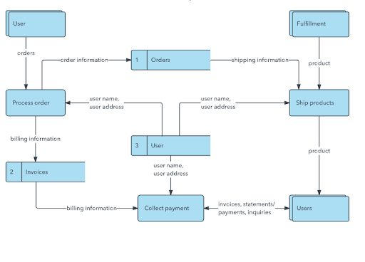
Methodology

Slide 7
Timeline of Project
The project is estimated to be completed in Four months, with the following milestones:
Month 1: Project Planning and Design
Month 2: Development and Testing
Month 3: Deploypment
Month 4: Maintenance and Support

Slide 8
Expected Outcomes
The Farmer’s Mart project envisions delivering an intuitive and secure online grocery shopping platform, simplifying user navigation and ensuring data privacy.
The outcome anticipates efficient order processing, real-time inventory tracking, and optimized inventory management for timely restocking.
By focusing on sustainability and quality assurance, the project aims to provide a competitive and reliable solution for consumers seeking diverse and eco-friendly grocery options.
The project aspires to reshape the digital grocery retail landscape, offering a trustworthy, responsive, and environmentally conscious platform.

Slide 9
Conclusion
In conclusion, the E-Farmer e-commerce website project holds great potential for transforming the agricultural landscape. By leveraging digital technologies, E-Farmer aims to empower farmers, enhance their access to essential products, and contribute to the overall development of the agricultural sector.
Farmer’s Mart is poised to revolutionize online grocery retail by prioritizing user-centric design, comprehensive product curation, and robust security measures. The streamlined approach, maintains a focus on efficient order processing, real-time inventory management, and responsive customer support. With an unwavering commitment to innovation, sustainability, and quality assurance, Farmer’s Mart aims to redefine the digital grocery shopping experience, providing a reliable and environmentally conscious platform for contemporary consumers

Slide 10
References
https://www.researchgate.net/profile/Poornima-Perera/publication/347936240_E-Farmer_Management_System_for_Empowering_Sri_Lankan_Small-Scale_Agriculture-Based_Producers/links/5fe8ad7fa6fdccdcb80c986e/E-Farmer-Management-System-for-Empowering-Sri-Lankan-Small-Scale-Agriculture-Based-Producers
https://ieeexplore.ieee.org/abstract/document/9791709/
https://jurnal.darmaagung.ac.id/index.php/jurnaluda/article/view/2852
https://sajet.in/index.php/journal/article/view/111
https://ieeexplore.ieee.org/abstract/document/8697478/
https://core.ac.uk/download/pdf/297933979.pdf
http://ejournal-ibik57.ac.id/index.php/junif/article/view/128
http://ir.kdu.ac.lk/handle/345/2994

Slide 11
Thank You

